Slide 1
Unit 2.3 Supreme Court Cases- Answers
Complete the Guided Reading / Structured Notes as you view the Power Point.

Slide 2
Standards:
Essential Standards:
CE.C&G.2.3 Evaluate the US Constitution as a "living Constitution" in terms of how the words in the Constitution and Bill of Rights have been interpreted and applied throughout their existence.
CE.C&G.3.1 Analyze how the rule of law establishes limits on both the governed and those who govern while holding true to the ideal of equal protection under the law
CE.C&G.3.4 Explain how individual rights are protected by varieties of law.
CE.C&G.3.8 Evaluate the rights of individuals in terms of how well those rights have been upheld by democratic government in the United States.

Slide 3
Unit 2.3 Supreme Court Cases Standards: 2.3, 3.1, 3.4, 3.8
FREEDOM OF SPEECH CASES:

Slide 4
Unit 2.3 Supreme Court Cases Standards: 2.3, 3.1, 3.4, 3.8
Schenck v. United States (1919)
Summary: The federal government passed the Espionage Act in 1917 to protect itself against people who opposed World War I. This meant it was against the law to promote resistance to the War. Schenck was convicted of conspiracy to violate the Espionage Act for encouraging people to oppose the war and its draft.
Ruling: Against Schenck
Amendment in Question: 1
Precedent: There are limits on free speech if it posed a “clear and present danger” to the public- You cannot yell “Fire” in a crowed room if it is not true.

Slide 5
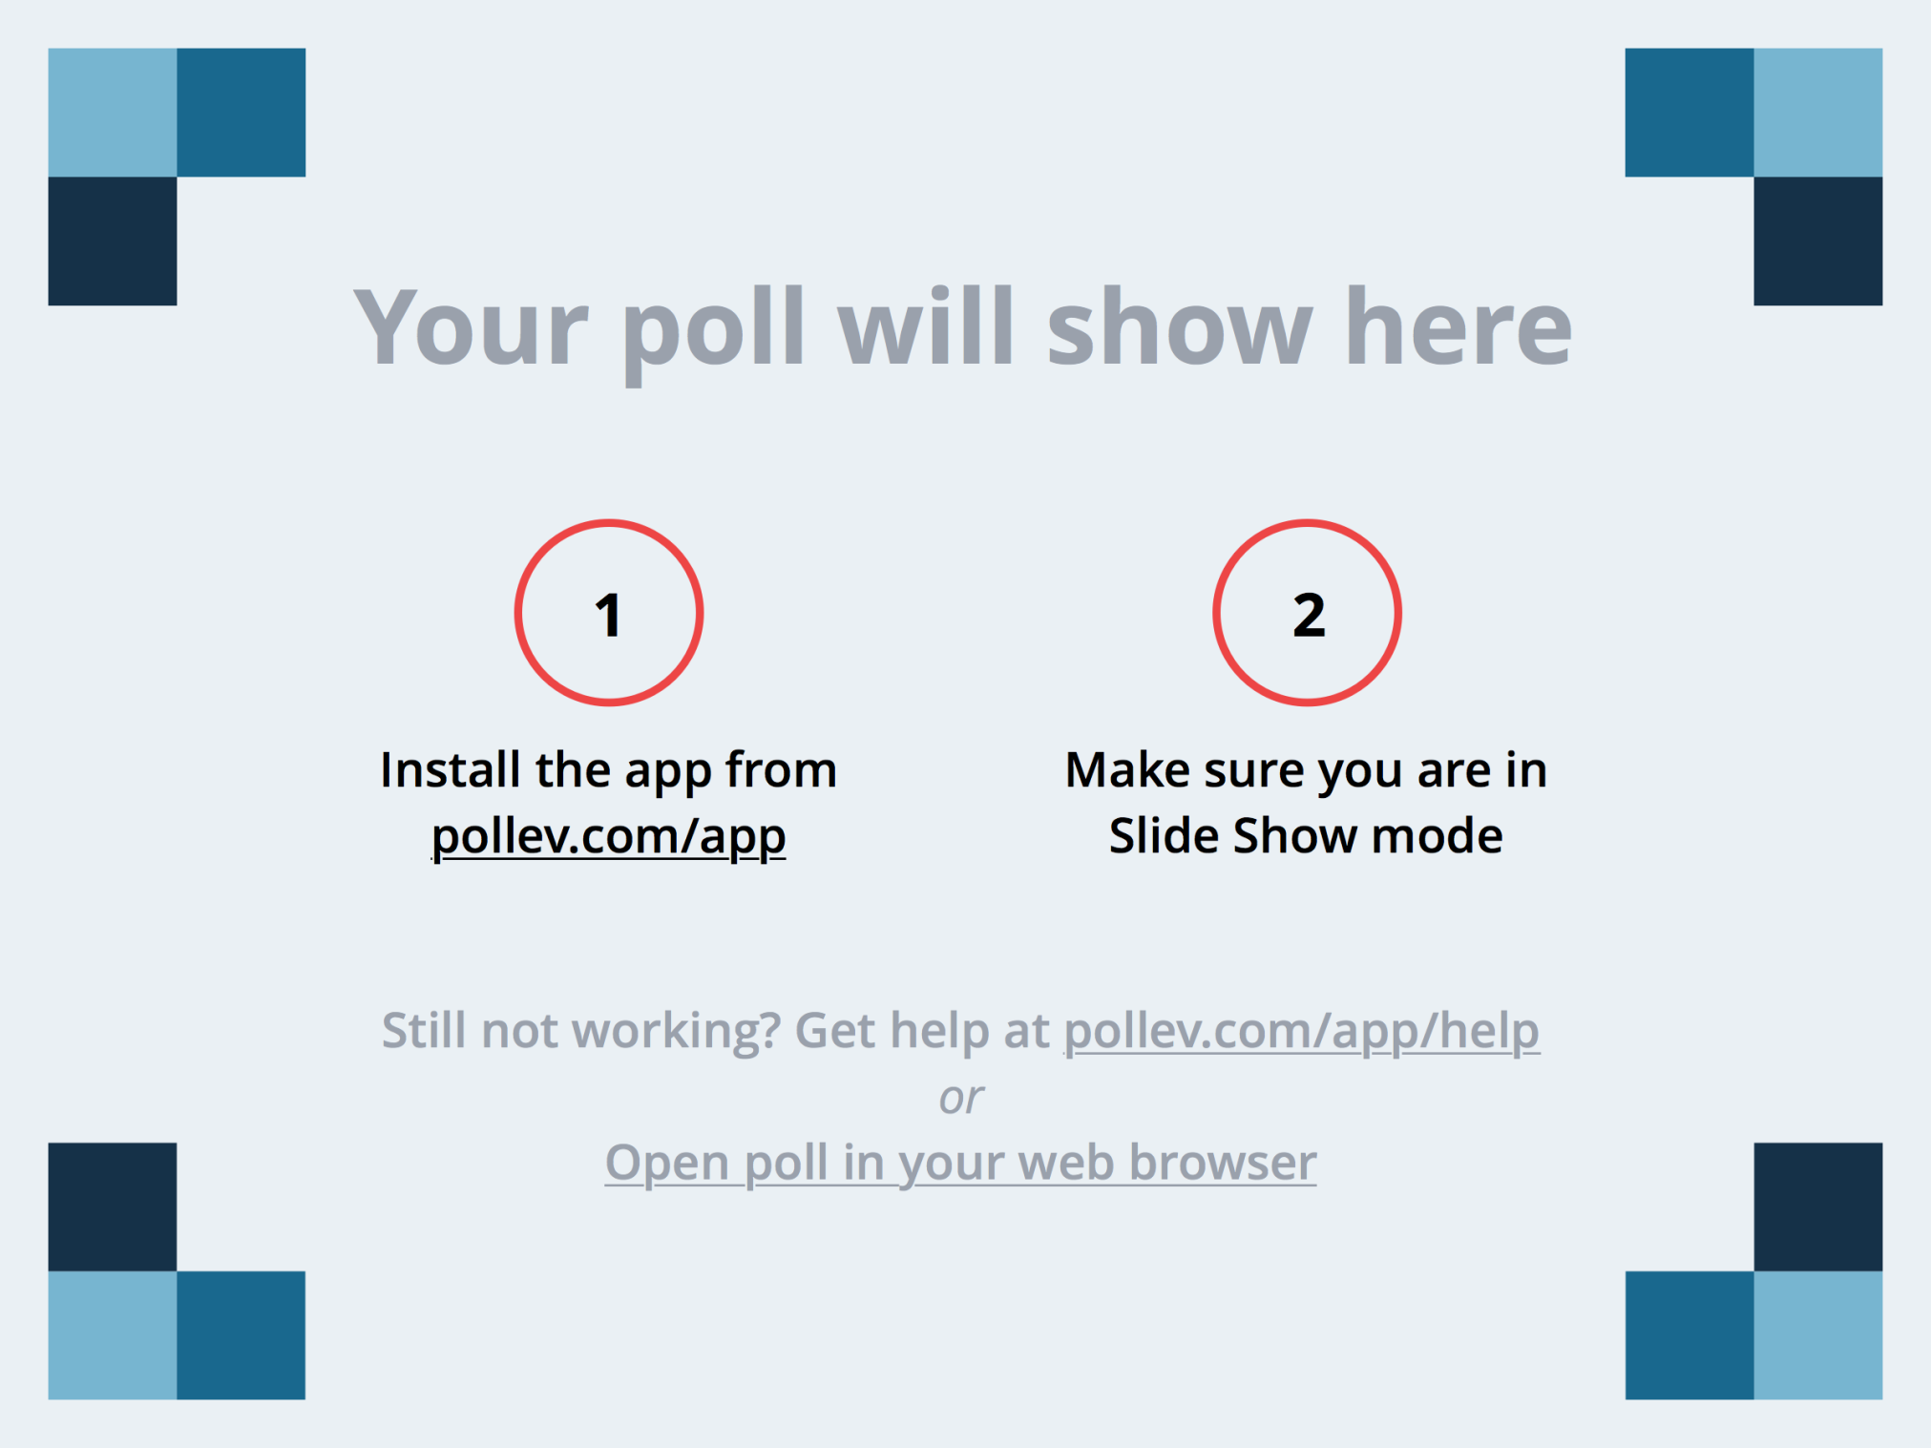
Notes:
How is free speech limited by the Schenck Case? https://www.polleverywhere.com/free_text_polls/raOZVWrBpL1t3vC#!/my/polls

Slide 6
Unit 2.3 Supreme Court Cases Standards: 2.3, 3.1, 3.4, 3.8
Tinker v. Des Moines (1969)
Summary: Students were suspended for wearing black armbands to protest Vietnam War
Ruling: For students
Amendment in Question: 1
Precedent: Schools cannot ban symbolic speech

Slide 7
Unit 2.3 Supreme Court Cases Standards: 2.3, 3.1, 3.4, 3.8
What type of symbolic speech can get you in trouble in school today?

Slide 8
Unit 2.3 Supreme Court Cases Standards: 2.3, 3.1, 3.4, 3.8
The Skokie Case (1977)
Summary: Nazis denied permit to march in an Illinois Jewish community
Ruling: For Nazis
Amendment in Question: 1
Precedent: A group cannot be denied their Constitutional rights based on their beliefs

Slide 9
Unit 2.3 Supreme Court Cases Standards: 2.3, 3.1, 3.4, 3.8
Should the KKK be allowed to march in Raleigh?

Slide 10
Notes:
How are schools limited by the Tinker Case? https://www.polleverywhere.com/free_text_polls/2kBrJcIG3mUVBiR#!/my/polls

Slide 11
Unit 2.3 Supreme Court Cases Standards: 2.3, 3.1, 3.4, 3.8
Bethel School District v. Fraser (1986)
Summary: Student was suspended for making lewd and obscene remarks during a school speech that disrupted and embarrassed students
Ruling: For the school
Amendment in Question: 1
Precedent: Schools can make rules to regulate speech

Slide 12
Unit 2.3 Supreme Court Cases Standards: 2.3, 3.1, 3.4, 3.8
In Bethel the Boy was Behaving Badly

Slide 13
Notes:
Why is it important to support the precedent of the Skokie Case? https://www.polleverywhere.com/free_text_polls/z69kdSgxi77PRRl#!/my/polls

Slide 14
Unit 2.3 Supreme Court Cases Standards: 2.3, 3.1, 3.4, 3.8
Hazelwood School District v. Kuhlmeier (1988)
Summary: School principal censored a school newspaper for writing articles about teen pregnancy and divorce
Ruling: For school
Amendment in Question: 1
Precedent: School principals can censor student publications

Slide 15
Unit 2.3 Supreme Court Cases Standards: 2.3, 3.1, 3.4, 3.8
Why can a principal censor you but the government cannot?

Slide 16
Notes:
How is free speech limited by the Bethel case? https://www.polleverywhere.com/free_text_polls/ETcTTJjfixY8c6n#!/my/polls

Slide 17
Unit 2.3 Supreme Court Cases Standards: 2.3, 3.1, 3.4, 3.8
Texas v. Johnson (1989)
Summary: Johnson was arrested for breaking Texas law against burning the flag to protest the government
Ruling: For Johnson
Amendment in Question: 1
Precedent: Legal to burn the flag in protest

Slide 18
Unit 2.3 Supreme Court Cases Standards: 2.3, 3.1, 3.4, 3.8
FREEDOM OF RELIGION CASES:

Slide 19
Unit 2.3 Supreme Court Cases Standards: 2.3, 3.1, 3.4, 3.8
Engel v. Vitale (1962)
Summary: Parents objected to opening school with a voluntary prayer
Ruling: Court ruled for the parents
Amendment in Question: 1
Precedent: School sponsored prayer is illegal in public schools

Slide 20
Unit 2.3 Supreme Court Cases Standards: 2.3, 3.1, 3.4, 3.8
Can students pray in a group at school?

Slide 21
Unit 2.3 Supreme Court Cases Standards: 2.3, 3.1, 3.4, 3.8
Abington v. Schempp (1963)
Summary: Parents objected to opening school with a voluntary scripture reading
Ruling: Court ruled for the parents
Amendment in Question: 1
Precedent: Daily scripture reading for religious purposes is illegal in public schools

Slide 22
Notes:
Is it legal for students to pray in school? https://www.polleverywhere.com/multiple_choice_polls/dLp6lcEcc0h9MJX#!/my/polls

Slide 23
Unit 2.3 Supreme Court Cases Standards: 2.3, 3.1, 3.4, 3.8
RIGHT TO PRIVACY CASES:

Slide 24
Unit 2.3 Supreme Court Cases Standards: 2.3, 3.1, 3.4, 3.8
Mapp v. Ohio (1961)
Summary: Police went to Mapp’s home looking for a fugitive. She denied them access to her home because they did not have a search warrant. They left and returned later with a “warrant.” Mapp grabbed the document and was then arrested by the police. Police searched her home but did not find the fugitive.
Instead they seized items considered “obscene material” and arrested her on obscenity charges.
Ruling: For Mapp
Amendment in Question: 4
Precedent: Exclusionary Rule- Evidence obtained by police in an illegal search and seizure will be excluded at trial

Slide 25
Unit 2.3 Supreme Court Cases Standards: 2.3, 3.1, 3.4, 3.8
Roe v. Wade (1973)
Summary: Texas had a state law that only allowed women to obtain abortions if their health or life was in jeopardy. A woman named Roe (not her real name) wanted an abortion and sued Texas to gain the right to an abortion.
Ruling: Court ruled in favor of Roe
Amendment in Question: 4
Precedent: Abortions legal in all 50 states.

Slide 26
Notes:
What is the Exclusionary Rule? https://www.polleverywhere.com/free_text_polls/uSYR9YwDJT27Bqx#!/my/polls

Slide 27
Unit 2.3 Supreme Court Cases Standards: 2.3, 3.1, 3.4, 3.8
TLO v. New Jersey (1985)
Summary: Student caught smoking in the school bathroom; taken to principal, searched; found cigarettes, papers, marijuana, list of students who owed her money, notes about drug deals
Ruling: For the school
Amendment in Question: 4
Precedent: School officials can search students based on “reasonable suspicion” “Probable cause” is not necessary.

Slide 28
Unit 2.3 Supreme Court Cases Standards: 2.3, 3.1, 3.4, 3.8
T. L. Oh No You Didn’t!

Slide 29
Notes:
What is needed for a search to be legal at school? https://www.polleverywhere.com/free_text_polls/I3yvJTT4h3RpGkl#!/my/polls

Slide 30
Unit 2.3 Supreme Court Cases Standards: 2.3, 3.1, 3.4, 3.8
RIGHTS OF THE ACCUSED CASES:

Slide 31
Unit 2.3 Supreme Court Cases Standards: 2.3, 3.1, 3.4, 3.8
Gideon v. Wainwright (1963)
Summary: Indigent (poor) Gideon was denied a court appointed attorney because his crime was not a capital offence (punishable by death)
Ruling: For Gideon
Amendment in Question: 6
Precedent: Criminal defendants are entitled to a court appointed attorney regardless of the type of crime

Slide 32
Unit 2.3 Supreme Court Cases Standards: 2.3, 3.1, 3.4, 3.8
With G-G-Gideon you G-G-Get an attorney

Slide 33
Unit 2.3 Supreme Court Cases Standards: 2.3, 3.1, 3.4, 3.8
Escobedo v. Illinois (1964)
Summary: Arrested for murdering his brother-in-law; asked for an attorney, denied an attorney, made incriminating statements
Ruling: For Escobedo
Amendment in Question: 5 and 6
Precedent: Criminals are entitled to have their attorney present during questioning

Slide 34
Notes:
What do you get as a result of the Gideon Case? https://www.polleverywhere.com/free_text_polls/HdxlpBwUcYZZFok#!/my/polls

Slide 35
Unit 2.3 Supreme Court Cases Standards: 2.3, 3.1, 3.4, 3.8
Miranda v. Arizona (1966)
Summary: Arrested on rape charges, questioned by police but not informed of 5th or 6th amendment rights, admitted he did it
Ruling: For Miranda
Amendment in Question: 5 and 6
Precedent: Police must read suspects their rights if they are under arrest and being questioned about a crime

Slide 36
Unit 2.3 Supreme Court Cases Standards: 2.3, 3.1, 3.4, 3.8
What is the Miranda Warning?

Slide 37
Unit 2.3 Supreme Court Cases Standards: 2.3, 3.1, 3.4, 3.8
In RE Gault (1967)
Summary: Gault, age 15, was arrested for making obscene remarks on the phone to a neighbor, his parents were not notified
Ruling: For Gault
Amendment in Question: 5 and 6
Precedent: Established rules for arresting, questioning, convicting and sentencing juveniles

Slide 38
Notes:
Identify the amendments covered in the Miranda Warning. https://www.polleverywhere.com/multiple_choice_polls/85A1bwAFgVFN6vV#!/my/polls

Slide 39
Unit 2.3 Supreme Court Cases Standards: 2.3, 3.1, 3.4, 3.8
CRUEL AND UNUSUAL PUNISHMENT CASES:

Slide 40
Unit 2.3 Supreme Court Cases Standards: 2.3, 3.1, 3.4, 3.8
Furman v. Georgia (1972)
Summary: Convicted and sentenced to death for murder committed during a burglary
Ruling: For Furman
Amendment in Question: 8
Precedent: Death penalty not unconstitutional, but procedures applied by states were biased against African Americans and the poor

Slide 41
Unit 2.3 Supreme Court Cases Standards: 2.3, 3.1, 3.4, 3.8
Gregg v. Georgia (1976)
Summary: Convicted of armed robbery and murder, Gregg sued stating that death was cruel and unusual
Ruling: Against Gregg
Amendment in Question: 8
Precedent: Cruel and unusual punishment concerned torture

Slide 42
Notes:
Why is the Death penalty not considered cruel and unusual punishment? https://www.polleverywhere.com/free_text_polls/XlYk0GCGj0XRkl3#!/my/polls

Slide 43
Unit 2.3 Supreme Court Cases Standards: 2.3, 3.1, 3.4, 3.8
CIVIL RIGHTS CASES:

Slide 44
Unit 2.3 Supreme Court Cases Standards: 2.3, 3.1, 3.4, 3.8
Plessy v. Ferguson (1896)
Summary: Mixed race man denied access to “whites only” train car
Ruling: Against Plessy
Amendment in Question: 14
Precedent: Segregation was legal as long as accommodations for blacks were equal to those of whites.
This is often called the “Separate but Equal” ruling

Slide 45
Unit 2.3 Supreme Court Cases Standards: 2.3, 3.1, 3.4, 3.8
Brown v. Board of Education of Topeka, Kansas (1954)
Summary: Parents in South Carolina, Kansas, and other states filed lawsuits against their local school districts claiming that the schools were violating the principle of “separate but equal.”
Ruling: For the Browns and ordered integration to occur “with all deliberate speed.”
Amendment in Question: 14
Precedent: Reversed the Plessy Decision- segregation ruled unconstitutional

Slide 46
Unit 2.3 Supreme Court Cases Standards: 2.3, 3.1, 3.4, 3.8
Little Linda Brown was Brown and wanted to go to an all white school

Slide 47
Notes:
Identify the amendment used to make the Plessy precedent. https://www.polleverywhere.com/multiple_choice_polls/FD4sw79XTLCbcBc#!/my/polls

Slide 48
Unit 2.3 Supreme Court Cases Standards: 2.3, 3.1, 3.4, 3.8
Korematsu v. United States (1945)
Summary: After Pearl Harbor, Korematsu was arrested and convicted for refusal to leave his home and move to an internment camp for Japanese Americans
Ruling: Against Korematsu
Amendment in Question: 14
Precedent: Actions such as internment camps are permitted during a time of “military urgency.”

Slide 49
Notes:
What part of the 14th amendment was used to overturn the Plessy decision? https://www.polleverywhere.com/free_text_polls/0yXXTY6Bj7ReVvi#!/my/polls

Slide 50
Unit 2.3 Supreme Court Cases Standards: 2.3, 3.1, 3.4, 3.8
Heart of Atlanta Hotel v. United States (1964)
Summary: Heart of Atlanta Hotel sued the United States to gain the right to continue their policy of segregation toward African Americans- they would not rent rooms to African Americans
Ruling: Against Hotel
Amendment in Question: 14
Precedent: Facilities that serve interstate customers must follow federal laws based on commerce clause of Constitution (Congress can regulate interstate trade)

Slide 51
Unit 2.3 Supreme Court Cases Standards: 2.3, 3.1, 3.4, 3.8
Swann v. Charlotte-Mecklenburg Board of Education (1971)
Summary: 1965 Swann applied to go to an all white school near his home- he was denied
Ruling: For Swann
Amendment in Question: 14
Precedent: Busing is an acceptable tool for integration

Slide 52
Notes:
How does busing support the 14th amendment? https://www.polleverywhere.com/free_text_polls/DJFJA4o4QIL53wS#!/my/polls

Slide 53
Unit 2.3 Supreme Court Cases Standards: 2.3, 3.1, 3.4, 3.8
California v. Bakke (1978)
Summary: Allan Bakke, a white man, had been denied twice for admission to the University of California Medical School at Davis. The school was using an Affirmative Action program in the admission process to help reverse discrimination in the medical profession. Bakke's GPA was below all the regular applicants, but his standardized tests were higher both years his applications were rejected. Bakke argued that he was excluded from admission to the school because of his race.
Ruling: Court ruled in favor of ­­­­­­­­­­­­­­­­­­­­­­­Bakke but indicated that a properly devised program might well be constitutionally valid.
Amendment in Question: 14
Precedent: 1. Giving preferential treatment to members of any one group based on race or ethnic origin is discrimination- 2. It was suggested that racial criteria may be used along with other requirements when making considerations for admission into a group

Slide 54
Unit 2.3 Supreme Court Cases Standards: 2.3, 3.1, 3.4, 3.8
Shaw v. Reno (1993)
Summary: After a shift in population, North Carolina created a predominately African American 12th voting district; citizens sued claiming that a district drawn based on racial criteria violated the 14th amendment
Ruling: Redistricting based on race must be held to a standard of strict scrutiny under the equal protection clause
Amendment in Question: 14
Precedent: racial gerrymandering is illegal

Slide 55
Unit 2.3 Supreme Court Cases Standards: 2.3, 3.1, 3.4, 3.8
CHECKS AND BALANCES CASES:

Slide 56
Unit 2.3 Supreme Court Cases Standards: 2.3, 3.1, 3.4, 3.8
Marbury v. Madison (1803)-
Summary: John Adams appointed Marbury as Justice of the Peace for Washington, D.C. before he left office “Midnight Appointments”-the new president, Thomas Jefferson told his secretary of state, James Madison, not to deliver the papers. Marbury sued for an order from the Supreme Court to make Madison deliver the papers making his appointment official in accordance with the Judiciary Act of 1789
Ruling: Against Marbury because Court said Congress didn’t have the power to make the Judiciary Act
Constitutional Question: Did Congress have the power to write the Judiciary Act?
Precedent: 1. Established the Supreme Court has the power to determine if laws passed by Congress are Constitutional (JUDICIAL REVIEW) 2. Established the Constitution is the Supreme law of the land

Slide 57
Unit 2.3 Supreme Court Cases Standards: 2.3, 3.1, 3.4, 3.8
Judicial Review: The Judicial Branch Reviews laws to check if they are Constitutional or Unconstitutional

Slide 58
Notes:
Explain the precedent in Marbury v. Madison. https://www.polleverywhere.com/free_text_polls/10B4VnRhUBVXg1a#!/my/polls

Slide 59
Unit 2.3 Supreme Court Cases Standards: 2.3, 3.1, 3.4, 3.8
United States v. Nixon (1974)
Summary: Prosecutor sued to force President Nixon to turn over subpoenaed tapes during the investigation of the Watergate break-in
Ruling: Against Nixon
Constitutional Question: Can the president claim executive privilege in order to cover up a crime?
Precedent: Presidents can only used executive privilege to protect national security, not to cover up a crime.

Slide 60
Unit 2.3 Supreme Court Cases Standards: 2.3, 3.1, 3.4, 3.8
Magna Carta:
Rule of Law: No one is above the law

Slide 61
Notes:
What constitutional principle supports the Nixon precedent? https://www.polleverywhere.com/free_text_polls/4QRsxT3Xd09mzB7#!/my/polls

Slide 62
Unit 2.3 Supreme Court Cases Standards: 2.3, 3.1, 3.4, 3.8
FEDERAL LAW
V.
STATE LAW:

Slide 63
Unit 2.3 Supreme Court Cases Standards: 2.3, 3.1, 3.4, 3.8
McCulloch v. Maryland (1819)
Summary: The Second Bank of the United States was a federal bank located in Baltimore, Maryland. Mr. McCullough was an employee of the federal Bank. The state of Maryland charged the Bank a tax. Mr. McCullough did not pay the tax. He was charged and found guilty for not paying a required state tax on the Baltimore, Maryland branch of The Second Bank of the United States.
Ruling: For McCullough
Constitutional Question: Can states tax federal activity?
Precedent: The Bank was a federal institution. Federal institutions cannot be taxed by states- supported Congress' implied powers

Slide 64
Unit 2.3 Supreme Court Cases Standards: 2.3, 3.1, 3.4, 3.8
Gibbons v. Ogden (1824)
Summary: The New York state Legislature allowed Aaron Ogden to have an exclusive license to run a ferry service on the Hudson River between New York and New Jersey. Thomas Gibbons wishing to make money on ferry transportation got a license from the federal government. Ogden said he had a right to the monopoly on the ferry service and took Gibbons to court.
Ruling: Court ruled in favor of Gibbons
Constitutional Questions: 1. What is the meaning of commerce? 2. Is interstate commerce a concurrent power?
Precedent: 1. Defined Commerce to include navigation and therefore determined Congress has the right to regulate navigation 2. Commerce Clause of the Constitution gives Congress the power to regulate interstate commerce- Constitution is the Supreme Law of the Land

Slide 65
Unit 2.3 Supreme Court Cases Standards: 2.3, 3.1, 3.4, 3.8
Commerce: Money and Trade

Slide 66
Notes:
Based on the Gibbons v. Ogden precedent, who controls interstate commerce? https://www.polleverywhere.com/free_text_polls/TP3XaUpcocKp0gs#!/my/polls

Slide 67
Unit 2.3 Supreme Court Cases Standards: 2.3, 3.1, 3.4, 3.8
NORTH CAROLINA
SUPREME COURT CASES:

Slide 68
Unit 2.3 Supreme Court Cases Standards: 2.3, 3.1, 3.4, 3.8
State v. Mann (1830)
Summary: Mann was found guilty of killing one of his slaves when she struggled to escape a whipping
Ruling: For Mann
Constitutional Questions: What rights do slaves have under the law?
Precedent: Slaves were the absolute property of their owners. Owners could not be convicted for killing a slave even if the death came from a beating.

Slide 69
Unit 2.3 Supreme Court Cases Standards: 2.3, 3.1, 3.4, 3.8
Leandro v. The State of North Carolina (1997)
Summary: Citizens alleged that students in poor counties were not getting an equal education compared to students in wealthy counties
Ruling: For Leandro
Constitutional Questions: 1. Is there a baseline level of education to which all children in N.C. are constitutionally entitled? 2. If so, what is it? 3. Who is responsible for providing this education?
Precedent: The State is required to educate all students equally regardless of socioeconomic status or location.

Slide 70
Notes:
What was the constitutional question in State v. Mann? https://www.polleverywhere.com/free_text_polls/bj5aapIc0oF7Aep#!/my/polls

Slide 71
Notes:
What precedent was established by the Leandro Case? https://www.polleverywhere.com/free_text_polls/nXrJI3KI7Zdp4kv#!/my/polls

