Slide 1
The Washington Administration
The First American President

Slide 2
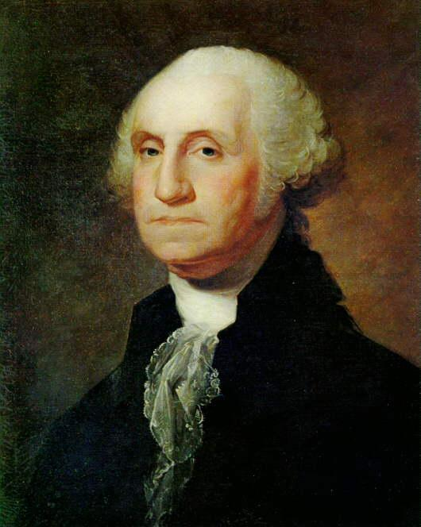
George Washington
A President Who Made Precedent

Slide 3
George Washington Heads the New Government
Goal 1: You will identify, investigate, and assess the effectiveness of the institutions of the emerging republic.

Slide 4
Creation of the Judicial System
Judiciary Act of 1789:
Clarified the federal court system
Needed because Article III of the Constitution was vague
Set up a Supreme Court with 5 justices / 1 chief (doh!)
Set up sixteen lower federal courts
Relation to goal 1?

Slide 5
Shapes the Executive Branch
Appoints a Cabinet:
A formal set of advisors to help him run the government

Slide 6
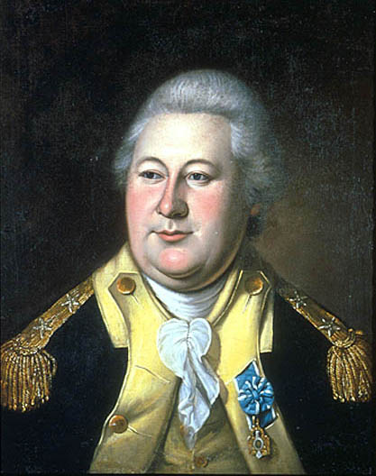
Department of War
Purpose:
To oversee national defense
Henry Knox

Slide 7
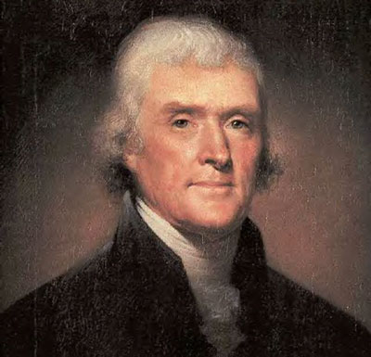
Department of State
Purpose:
To deal with other nations
Thomas Jefferson

Slide 8
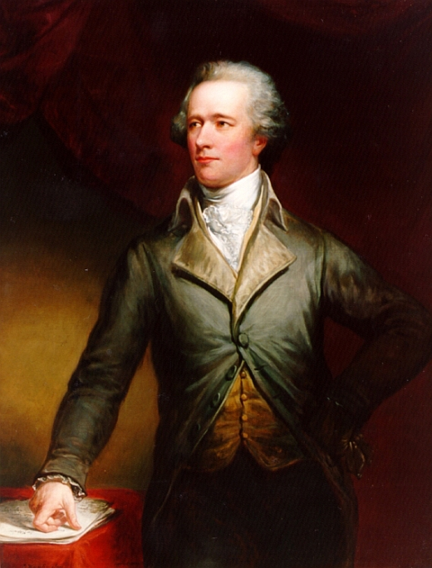
Department of Treasury
Purpose:
To handle the nation’s finances
Alexander Hamilton

Slide 9
Hamilton’s Economic Plan and the National Bank
Economic Problems:
The U.S. gov’t. is in debt to foreign nations and people who bought U.S. bonds. Will we pay the lenders back?
Some states are in debt to foreign nations.
Where will tax $ be kept and money be printed?
How will the U.S. raise money?
How will we get people to pay their taxes?
See Hamilton’s Economic Plan: For and Against Chart

Slide 10
Component | Arguments For It | Arguments Against It
Have the federal government pay off foreign debts and assume states’ debts | The U.S. will build credit / gain legitimacy with foreign nations. States will not be attacked due to failure to repay debts. | The South had already paid their debts, and so did not feel they should also help the North pay theirs.

Slide 11
Component | Arguments For It | Arguments Against It
 | The government would be supported by wealthy bondholders who would want the gov’t to succeed so they get paid!. | Some wealthy people had bought bonds from poorer people at a greatly reduced price; they would now be the ones to profit from speculation.
Reissue bonds to holders and pay them in full when they mature.

Slide 12
Component | Arguments For It | Arguments Against It
Establish a national bank | It would issue money, handle tax receipts and other gov’t. funds. Since wealthy people would partial investors, they would be tied to the success of the government. | Some feared a plutocracy could result – rule by the rich. Also, the constitution does not specifically provide for a national bank. It’s establishment would be unconstitutional.

Slide 13
Component | Arguments For It | Arguments Against It
Raise a tax on imported goods | This tax would raise lots of badly-needed money for the new government. Also, U.S. industries will grow, since foreign made goods would be more expensive. | Since the South imports more stuff, because they have fewer ports, they will pay an unfair share of taxes.

Slide 14
Component | Arguments For It | Arguments Against It
Raise an excise tax on whiskey | This would raise a lot of money, and besides, whiskey is sinful, and anyone buying or using it should be taxed. | This unfairly hurts the poor farmers in the Appalachians who grow corn, but make it more transportable and profitable by making it into whiskey. It’s a regressive tax.

Slide 15
Component | Arguments For It | Arguments Against It
Put down tax rebellions with a strong federal force | People need to know that the federal government can and will enforce federal law. Tax rebellions will not be tolerated. A large military force should be sent to put down the rebellious farmers. | Given the fact the tax was unfair, the tax rebellion is somewhat justified. To solve the crisis, the tax should simply be lifted.

Slide 16
The District of Columbia
The nation’s capital is moved to Northern VA, from NY
They needed to bribe the South into supporting Hamilton’s economic plan.

Slide 17
The Whiskey Rebellion
Washington sends 10,000 troops to smush a tax revolt of PA farmers opposed to the Whiskey tax.
People now know the federal gov’t. will crack down on lawlessness.

Slide 18
The Birth of Political Parties
Supporters of Hamilton and Jefferson’s views start to divide into two different factions.
Become established political parties.
Was not anticipated in the Constitution.
See “The Washington Administration and the Development of Political Parties” chart.

Slide 19
Hamilton vs Jefferson
Issue | Hamilton / Federalists | Jefferson / Republicans
Federalism | Strong national gov’t . | Strong state gov’ts.
Who should rule? | Educated elite | Common men
Interpretation of the Constitution | Loose | Strict
Economic Policy | Support Hamilton’s Economic Plan | Oppose Hamilton’s Plan
Supporters | Northerners, east coast elites, manufacturers, merchants | Southerners, frontier farmers, common people

Slide 20
Party Time!
1 | Tariff | 8 | Funding | 15 | Democratic Republicans | 22 | Jefferson | 29 | Hamilton
2 | Tariff | 9 | National Bank | 16 | Democratic Republicans | 23 | Hamilton | 30 | Federalists
3 | Bank | 10 | Whiskey Rebel | 17 | Jefferson | 24 | Wealthy person | 31 | Strict Interpretationj
4 | Bank | 11 | Whiskey Rebel | 18 | Hamilton | 25 | Wealthy person | 32 | Hamilton
5 | Strict Construction | 12 | Whiskey Rebel | 19 | Jefferson | 26 | Washington | 33 | Washington
6 | Strict Construction | 13 | Loose Construction | 20 | Federalists | 27 | Jefferson | 34 | Jefferson
7 | Funding | 14 | Loose Construction | 21 | Hamilton | 28 | Hamilton

Slide 21
Matchups
1/17
2/18
3/19
4/20
5/21
6/22
7/23
8/24
9/25
10/26/
11/27
12/28
13/29
14/30
15/31
16/32
33/34

